Slide 1
Slave Escape Route
Circa 1850

Slide 2
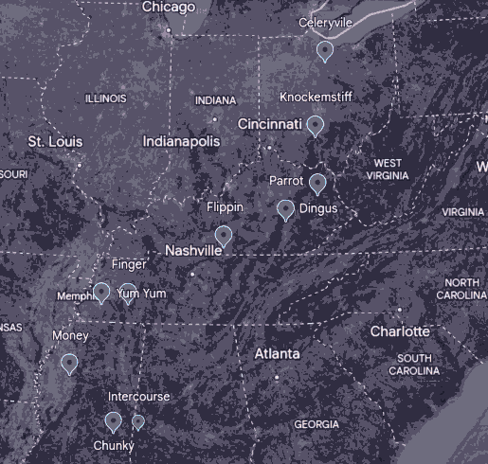
Route
Our group of slaves starts in Intercourse, Alabama (all real towns, we swear). They travel from station to station, ending in Celeryville, Ohio.

Slide 3

Escape
Escaping the plantation is the most difficult part, and the most dangerous. Our group makes a distraction and escapes at night.
The slave song Sweet Chariot would be sung to signal that a slave was soon to be escaping. This was Harriet Tubman's favorite song.
This quilt would signal that the slaves should pack their belongings as they were about to embark on their escape on the underground railroad.

Slide 4

Intercourse -> Chunky
When the slaves first escaped, there were in the most danger of being caught. Because of this, our group of escapees will be hiding at a station in Chunky, Alabama until the danger passes. The group travels along Alamuchee creek to mask their scents from the dogs that will be inevitably chasing them.
The log cabin quilt would signal that a station was safe to stay at

Slide 5

Chunky -> Money -> Yum Yum -> Finger
The group travels between stations to get to Finger, the next big step of their journey. These stations are very important, as they can resupply and rest. The most dangerous part of the escape is now over, as they are now far enough away from the plantation that they have lost their pursuers. Unfortunately, they are visually distinct, and would be instantly recognised as runaway slaves. Travelling at night was usually the safest option.
The shoofly quilt would tell the slaves who the railroad workers were.

Slide 6

Finger -> Flippin
Our group gets a signal to take the bears path, this leads them on a long stretch without a station. This is the hardest part of their journey yet.
The bears claw quilt told the escapees to take a mountain trail

Slide 7
Flippin -> Parrot
Our escapees now go from Flippin to Parrot. They run into a small settlement; unfortunately, they are immediately identified as runaway slaves. Thankfully, they had acquired a gun at Yum Yum. They shoot their attacker, but the danger is not over yet, as others must have heard the gunshot. While running away, they get lost; unfortunately, they didn't pack enough supplies for the extended trip and go hungry. They barely make it to the station in Parrot.

Slide 8
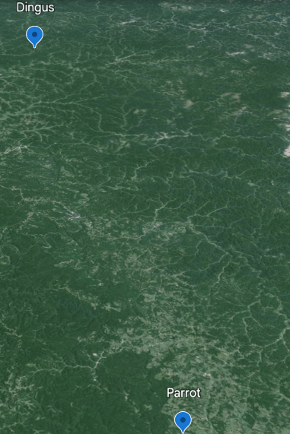
Parrot -> Dingus
The route from Parrot to Dingus is 106 km long and the terrain is very hilly and steep. The escapees also travel in gullies, where they are very prone to being ambushed and caught.

Slide 9
Dingus -> Knockemstiff
The journey from Dingus to Knockemstiff is perilous, but once they got into Ohio they were safe from the slave catchers/hunters. Unfortunately, they run into a drunk racist, who mildly wounds one of the party members. They manage to Knockemstiff together, though.

Slide 10
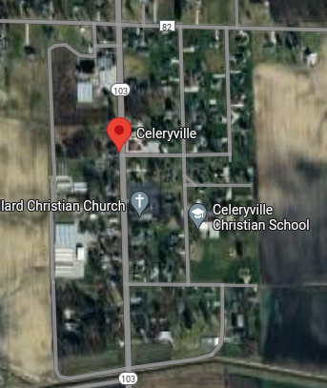
Knockemstiff -> Celeryville
While the group should be safe, bounty hunters are still roaming around southern Ohio. To be careful they go to Celeryville, which is further north, and safer.

